Slide 1
TIP!
Keep animation in place Replace Logo’s by right clicking image and choose “Change Picture…”

Slide 2

Story time

Slide 3


Illia Lebid
IT Engineer at ABN AMRO
Working on iDeal 2.0

Slide 4


TIP!
Keep animation in place Replace Logo’s by right clicking image and choose “Change Picture…”
Full proof testing
A guide to stable application

Slide 5
Types of tests
Unit
Contracts
Functional
Memory leakage
E2E
Snapshots
Accessibility
Security
Performance
Code quality
Mutation

Slide 6
Manual
Testing pyramid
Functional
Static
(Performance, Security, Code quality, Mutation, Memory leakage, Contracts, Accessibility, Snapshots)
E2E
Unit

Slide 7
Manual
Testing pyramid
Functional
Static
(Performance, Security, Code quality, Mutation, Memory leakage, Accessibility, Snapshots)
E2E
Unit

Slide 8
Manual
Testing pyramid
Functional
Static
(Performance, Security, Code quality, Mutation, Memory leakage, Accessibility, Snapshots)
E2E
Unit
(and maybe Contracts)

Slide 9
Manual
Testing pyramid
Functional
Static
(Performance, Security, Code quality, Mutation, Memory leakage, Accessibility, Snapshots)
E2E
Unit
(and maybe Contracts)

Slide 10
Manual
Testing pyramid
Functional
Static
(Performance, Security, Code quality, Mutation, Memory leakage, Accessibility, Snapshots)
E2E
Unit
(and maybe Contracts)

Slide 11
Manual
Testing pyramid
Functional
Static
(Performance, Security, Code quality, Mutation, Memory leakage, Accessibility, Snapshots)
E2E
Unit
(and maybe Contracts)

Slide 12

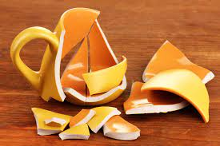

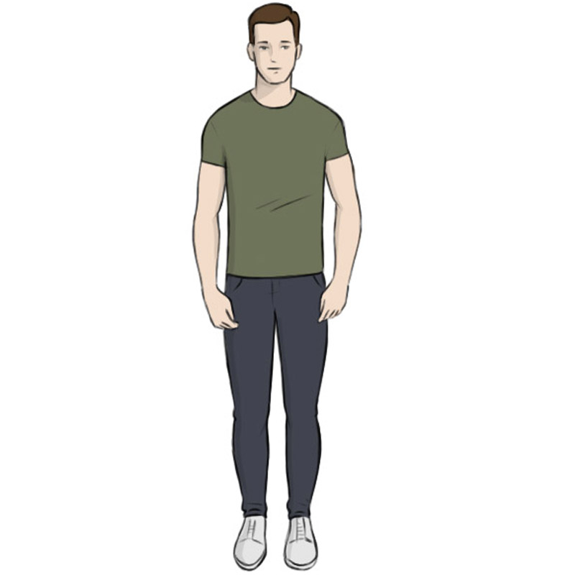


Traceability matrix
Actions | Expected result | Is tested
 |  | YES
 |  | NO

Slide 13
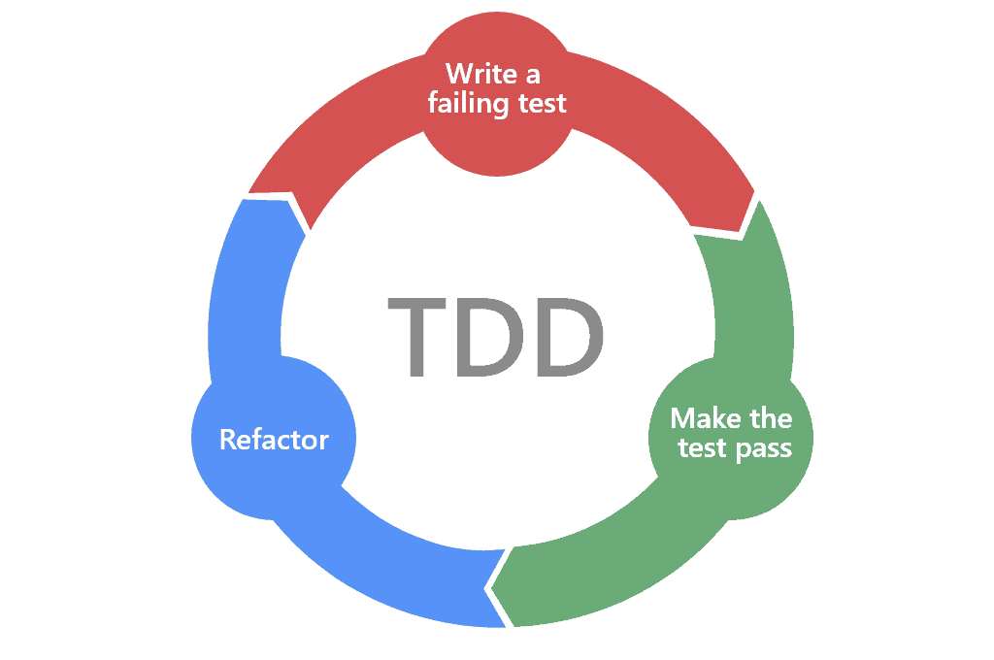
Test driven development

Slide 14
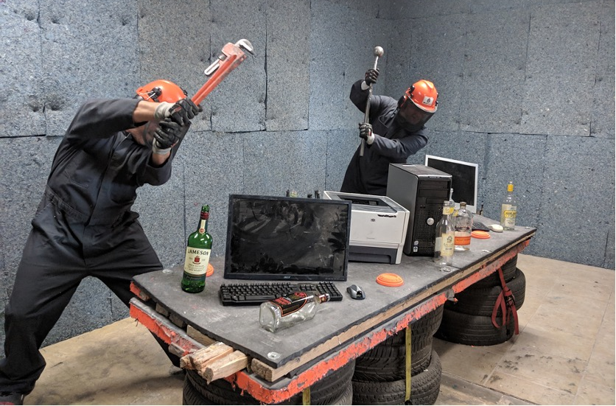
Breaking the tests

Slide 15
Integration with the pipeline

Slide 16
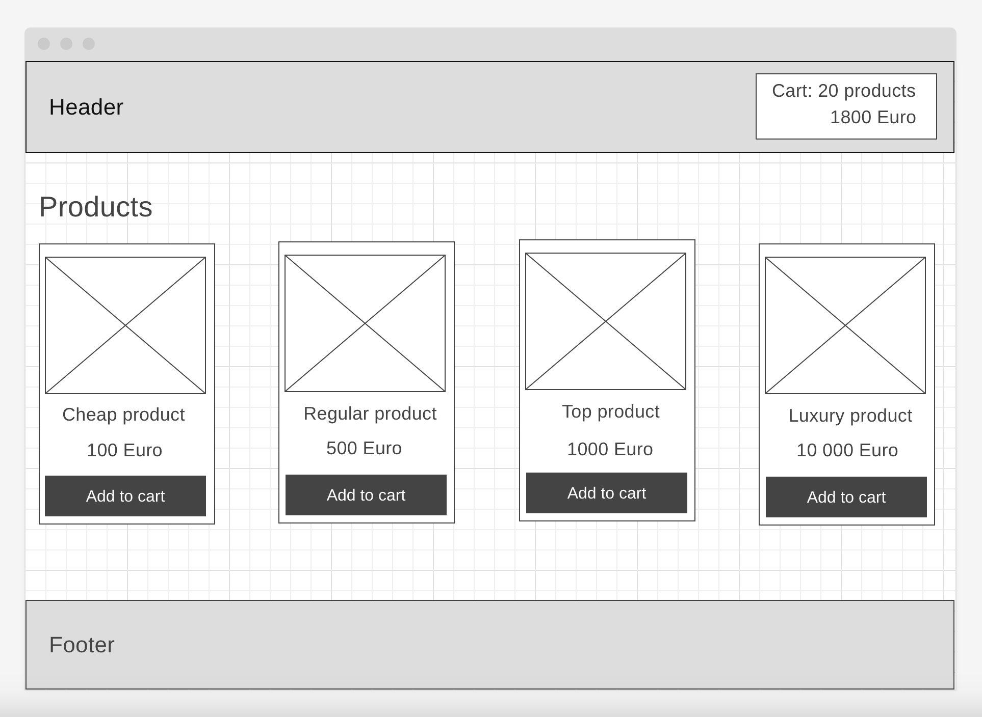
Example time

Slide 17
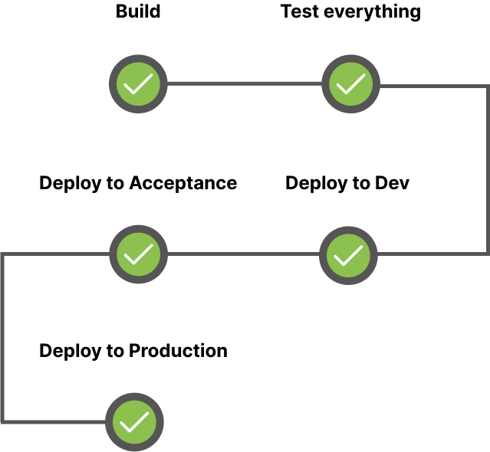

Pipeline and static tests

Slide 18
Traceability matrix (Catalog)
Actions | Expected result | Is tested
User opens catalog | List of products is shown | NO
User doesn’t have any product in the cart | Header cart shows no products | NO
User adds several products to the product cart | Header cart counter and total price is updated | NO
User adds products on price higher than 1000Euro | Header cart applies 10% discount | NO
Backend responds with error | Error modal is shown with correct message | NO

Slide 19
Traceability matrix (Product cart)
Actions | Expected result | Is tested
User opens product cart | List of user’s cart products is shown | NO
User opens product cart | Total price is shown | NO
Products cart’s total price is higher than 1000 | 10% discount is applied to total price | NO
User increases amount of product items in cart | Total price is updated | NO
User decreases amount of product items in cart | Total price is updated | NO
Update total price is higher/lower than 1000 | 10% discount is enabled/disabled | NO
User refreshes page | Cart changes are persisted | NO
Backend responds with error | Error modal with correct message is shown | NO

Slide 20
Traceability matrix (Checkout)
Actions | Expected result | Is tested
User opens checkout | Checkout form is displayed | NO
User doesn’t fill anything in checkout and submits the form | Validation messages are displayed. Form is not submitted. | NO
User fills everything correct and receives error response from the backend | Error messages are displayed. | NO
User fills everything correctly and receives success response from the backend | Payment page is shown | NO

Slide 21
Traceability matrix (Payment)
Actions | Expected result | Is tested
User opens payments page | Correct price and product details are displayed | NO
User pays and he has enough money | Payment is successful | NO
User pays and he doesn’t have enough money | An error is shown, payment is not made | NO
User tries again after failed attempt and he has enough money | Payment is successful. Success page is shown | NO
User pays and he has enough money | Payment is successful. Success page is shown | NO
User pays and he receives unexpected error response from the backend | An error is shown, payment is not made | NO

Slide 22


Example (Unit testing)
function calculateDiscount(price) {
}
It should:
Give 0% discount if price is less than 1000
Give 10% discount if price is more than 1000
Throw an error if price is not provided
> calculateDiscount(10)
undefined

Slide 23

Example (Unit testing)
function calculateDiscount(price) {
return price;
}
It should:
Give 0% discount if price is less than 1000
Give 10% discount if price is more than 1000
Throw an error if price is not provided
> calculateDiscount(10)
10

Slide 24
Example (Unit testing)
function calculateDiscount(price) {
return price;
}
It should:
Give 0% discount if price is less than 1000
Give 10% discount if price is more than 1000
Throw an error if price is not provided
> calculateDiscount(5000)
5000

Slide 25
Example (Unit testing)
function calculateDiscount(price) {
if(price >= 1000) return price * 0.1;
return price;
}
It should:
Give 0% discount if price is less than 1000
Give 10% discount if price is more than 1000
Throw an error if price is not provided
> calculateDiscount(5000)
4500

Slide 26
Example (Unit testing)
function calculateDiscount(price) {
if(price >= 1000) return price * 0.1;
return price;
}
It should:
Give 0% discount if price is less than 1000
Give 10% discount if price is more than 1000
Throw an error if price is not provided
> calculateDiscount()
undefined

Slide 27
Example (Unit testing)
function calculateDiscount(price) {
if(!price) throw new Error('PriceIsARequiredParameter’);
if(price >= 1000) return price * 0.1;
return price;
}
It should:
Give 0% discount if price is less than 1000
Give 10% discount if price is more than 1000
Throw an error if price is not provided
> calculateDiscount()
Uncaught error: PriceIsARequiredParameter

Slide 28
Example (Unit testing)
function calculateDiscount(price) {
if(!price) throw new Error('PriceIsARequiredParameter’);
if(price >= 1000) return price * 0.1;
return price;
}
It should:
Give 0% discount if price is less than 1000
Give 10% discount if price is more than 1000
Throw an error if price is not provided
> calculateDiscount('Free')
Free

Slide 29
Example (Unit testing)
function calculateDiscount(price) {
if(!price) throw new Error('PriceIsARequiredParameter’);
if(price >= 1000) return price * 0.1;
return price;
}
It should:
Give 0% discount if price is less than 1000
Give 10% discount if price is more than 1000
Throw an error if price is not provided
Throw an error if price is not a number
> calculateDiscount('Free')
Free

Slide 30
Example (Unit testing)
function calculateDiscount(price) {
if(typeof price === 'number') {
throw new Error(PriceMustBeNumber’);
}
if(!price) throw new Error('PriceIsARequiredParameter’);
if(price >= 1000) return price * 0.1;
return price;
}
It should:
Give 0% discount if price is less than 1000
Give 10% discount if price is more than 1000
Throw an error if price is not provided
Throw an error if price is not a number
> calculateDiscount('Free')
Uncaught error: PriceIsARequiredParameter

Slide 31
Example (Unit testing)
function calculateDiscount(price) {
if(typeof price === 'number') {
throw new Error(PriceMustBeNumber’);
}
if(!price) throw new Error('PriceIsARequiredParameter’);
if(price >= 1000) return price * 0.1;
return price;
}
It should:
Give 0% discount if price is less than 1000
Give 10% discount if price is more than 1000
Throw an error if price is not provided
Throw an error if price is not a number
> calculateDiscount(1000)
900

Slide 32
Example (Unit testing)
function calculateDiscount(price) {
if(typeof price === 'number') {
throw new Error(PriceMustBeNumber’);
}
if(!price) throw new Error('PriceIsARequiredParameter’);
if(price > 1000) return price * 0.1;
return price;
}
It should:
Give 0% discount if price is less than 1000
Give 10% discount if price is more than 1000
Throw an error if price is not provided
Throw an error if price is not a number
> calculateDiscount(1000)
1000

Slide 33
Example (Unit testing)
function calculateDiscount(price) {
if(typeof price === 'number') {
throw new Error(PriceMustBeNumber’);
}
if(!price) throw new Error('PriceIsARequiredParameter’);
if(price > 1000) return price * 0.1;
return price;
}
It should:
Give 0% discount if price is less than 1000
Give 10% discount if price is more than 1000
Throw an error if price is not provided
Throw an error if price is not a number
Give 10% discount if price is 1000
> calculateDiscount(1000)
1000

Slide 34
Example (Unit testing)
function calculateDiscount(price) {
if(typeof price === 'number') {
throw new Error(PriceMustBeNumber’);
}
if(!price) throw new Error('PriceIsARequiredParameter’);
if(price >= 1000) return price * 0.1;
return price;
}
It should:
Give 0% discount if price is less than 1000
Give 10% discount if price is more than 1000
Throw an error if price is not provided
Throw an error if price is not a number
Give 10% discount if price is 1000
> calculateDiscount(1000)
900

Slide 35
Functional tests
Happy Flow (Without discount. Including validation)
Happy Flow (With discount)
Error flow (Catalog)
Error flow (Cart)
Error flow (Checkout)
Error flow (Payment)

Slide 36
Functional tests (Happy flow)
test('Happy Flow', async () => {
await Catalog.loadPage();
});

Slide 37
Functional tests (Happy flow)
test('Happy Flow', async () => {
await Catalog.loadPage();
await Catalog.displaysProducts();
});

Slide 38
Functional tests (Happy flow)
test('Happy Flow', async () => {
await Catalog.loadPage();
await Catalog.displaysProducts();
await HeaderCart.shows('No products’);
});

Slide 39
Functional tests (Happy flow)
test('Happy Flow', async () => {
await Catalog.loadPage();
await Catalog.displaysProducts();
await HeaderCart.shows('No products’);
await Catalog.addProductToCart('Cheap Product’);
await HeaderCart.shows('1 product', '100Euro’);
});

Slide 40
Functional tests (Happy flow)
test('Happy Flow', async () => {
await Catalog.loadPage();
await Catalog.displaysProducts();
await HeaderCart.shows('No products’);
await Catalog.addProductToCart('Cheap Product’);
await HeaderCart.shows('1 product', '100Euro’);
await Catalog.addProductToCart('Cheap Product’);
await Catalog.addProductToCart('Cheap Product’);
await HeaderCart.shows('3 products', '300Euro’);
});

Slide 41
Functional tests (Happy flow)
test('Happy Flow', async () => {
await Catalog.loadPage();
await Catalog.displaysProducts();
await HeaderCart.shows('No products’);
await Catalog.addProductToCart('Cheap Product’);
await HeaderCart.shows('1 product', '100Euro’);
await Catalog.addProductToCart('Cheap Product’);
await Catalog.addProductToCart('Cheap Product’);
await HeaderCart.shows('3 products', '300Euro’);
await HeaderCart.goToCart();
await Cart.showsProducts();
await Cart.showsTotalPrice('300Euro’);
});

Slide 42
Functional tests (Happy flow)
test('Happy Flow', async () => {
await Catalog.loadPage();
await Catalog.displaysProducts();
await HeaderCart.shows('No products’);
await Catalog.addProductToCart('Cheap Product’);
await HeaderCart.shows('1 product', '100Euro’);
await Catalog.addProductToCart('Cheap Product’);
await Catalog.addProductToCart('Cheap Product’);
await HeaderCart.shows('3 products', '300Euro’);
await HeaderCart.goToCart();
await Cart.showsProducts();
await Cart.showsTotalPrice('300Euro’);
await Cart.decreaseProductAmount('Cheap Product’);
await Cart.decreaseProductAmount('Cheap Product’);
await Cart.increaseProductAmount('Cheap Product');
await Cart.showsTotalPrice(‘100Euro’);
});

Slide 43
Functional tests (Happy flow)
test('Happy Flow', async () => {
await Catalog.loadPage();
await Catalog.displaysProducts();
await HeaderCart.shows('No products’);
await Catalog.addProductToCart('Cheap Product’);
await HeaderCart.shows('1 product', '100Euro’);
await Catalog.addProductToCart('Cheap Product’);
await Catalog.addProductToCart('Cheap Product’);
await HeaderCart.shows('3 products', '300Euro’);
await HeaderCart.goToCart();
await Cart.showsProducts();
await Cart.showsTotalPrice('300Euro’);
await Cart.decreaseProductAmount('Cheap Product’);
await Cart.decreaseProductAmount('Cheap Product’);
await Cart.increaseProductAmount('Cheap Product');
await Cart.showsTotalPrice(‘100Euro’);
await Cart.goToCheckout();
await Checkout.fillUserData();
await Checkout.submitForm();
await Payment.pay(); await Success.showsSuccess();
});

Slide 44
E2E tests
Happy Flow

Slide 45


Q&A
My LinkedIn https://www.linkedin.com/in/illia-lebid

